Slide 1
Good Morning!

Slide 2
CHEST RADIOGRAPHS:
More Than 50 Shades of Grey*
Donna Magid, MD, M.Ed
* More like 1024…

Slide 3
Lecture objectives
Introduction and basic approach to the chest radiograph (Ur unit of imaging)
Correlation between anatomy and radiology
Extrapolation from image to patient
Just a hint of future clinical relevance … which will be revisited and expanded across this Horizontal Strand

Slide 4
Wilhelm Conrad Röentgen
Nov. 1895 “On a New Kind of Rays”
“I have seen my death!” Anna Ludwig
Notes:
November 1895 produced and detected first x-ray

Slide 5
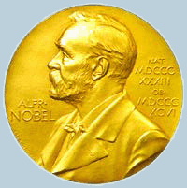
Wilhelm Conrad Röentgen
1st Nobel in Physics, 1901
Refused, like Curie, to take out patents; believed all mankind should benefit
Notes:
Won first nobel prize in physics in 1901

Slide 6
What determines BLACK →GREY→ WHITE?
Atomic # n and path length
Lead
Metals
Bone
Muscle
Blood
Liver
Fat
Air
WHITE:
Radioopaque;
“More”
Like Metal
BLACK :
Radiolucent;
“Less”
Like Air
Schematic derived from Squires Fundamentals of Radiology- Sixth Edition

Slide 7
Metal (VERY white)
Air (VERY black)
Bone (relatively white)
Soft tissue (relatively gray)

Slide 8
Ideal Study: PA and Lateral Images

Slide 9
“ONE View is NO View”

Slide 10
AP vs PA Chest xray’s path, (source→cassette)
X
A→P
P→A

Slide 11
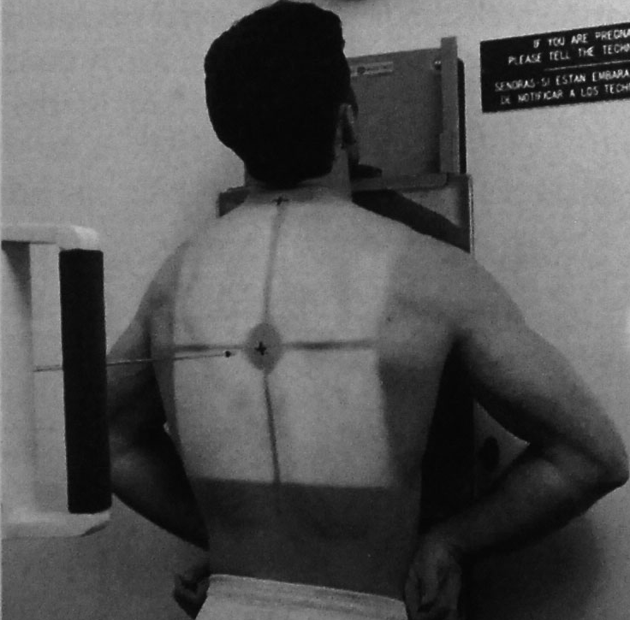
Posterior-Anterior (PA) Radiograph
Describes travel path of X Rays, tube-to-cassette

Slide 12
Posterior-Anterior (PA) Radiograph

Slide 13
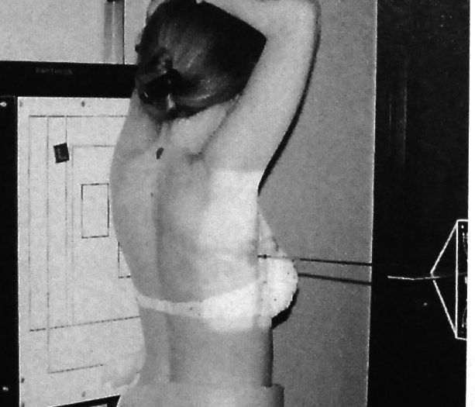
Lateral Radiograph

Slide 14
Lateral Radiograph

Slide 15
Preferred Chest Study: PA and Lateral Images

Slide 16
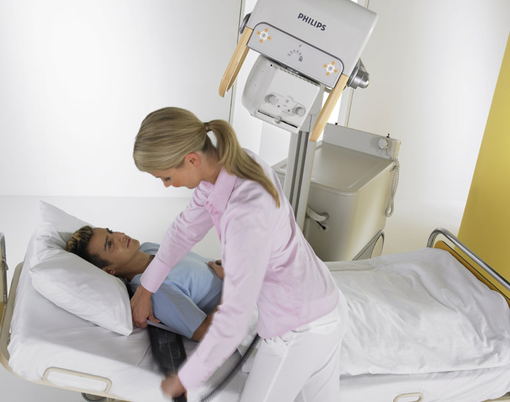
The Reality: AP or Portable Image

Slide 17
AP Chest, Portable
No lateral possible
Positioning suboptimal, lordotic (leaning back)
Hypoinflated
ONLY IF CLINICALLY WARRANTED!

Slide 18
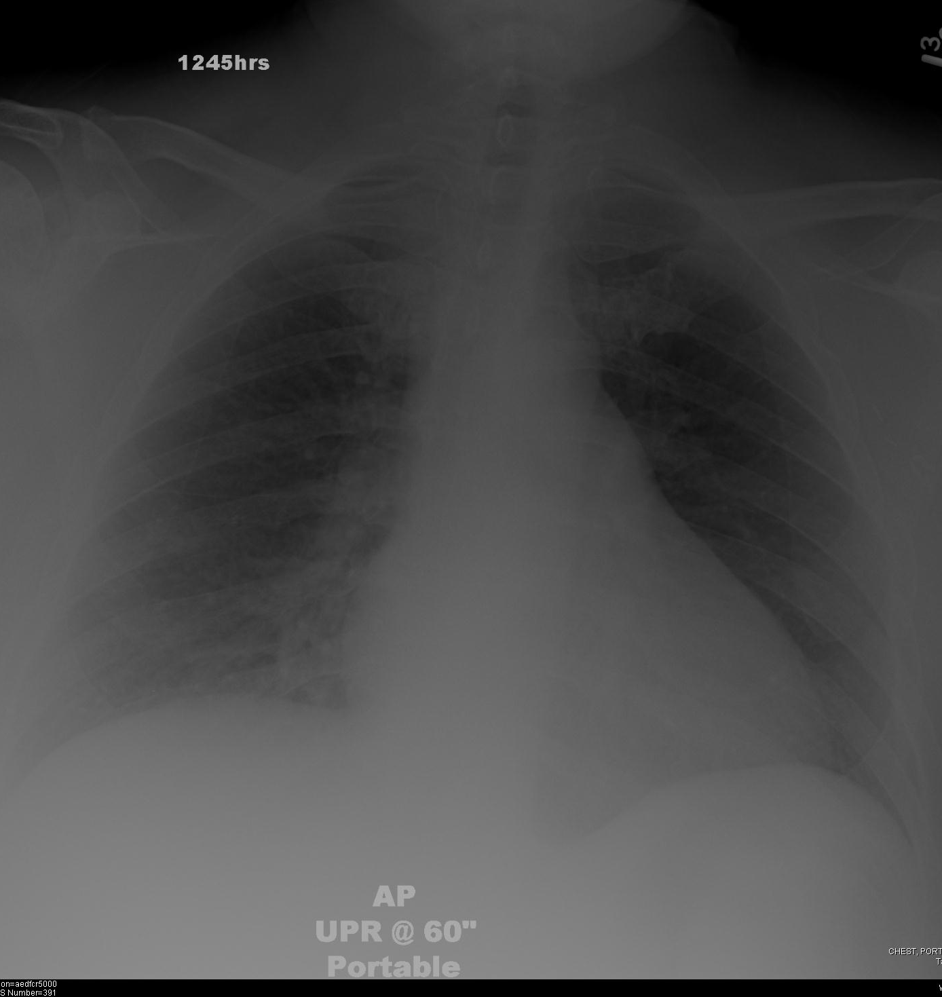
The Reality: AP or Portable Image

Slide 19
The Ideal Study: PA and Lateral Images

Slide 20
“ABC” Approach
Airway
Effusions
Bones
Fields (Lung)
Cardiac
Gastric Bubble
Diaphragm
Hardware

Slide 21
A

Slide 22
Airway

Slide 23
“Tracheal Deviation”

Slide 24
B

Slide 25
Bones

Slide 26
Thoracic Scoliosis: Spinal Curvature

Slide 27
C

Slide 28
Cardiac

Slide 29
Coronary Artery Bypass Graft Surgery (CABG)

Slide 30
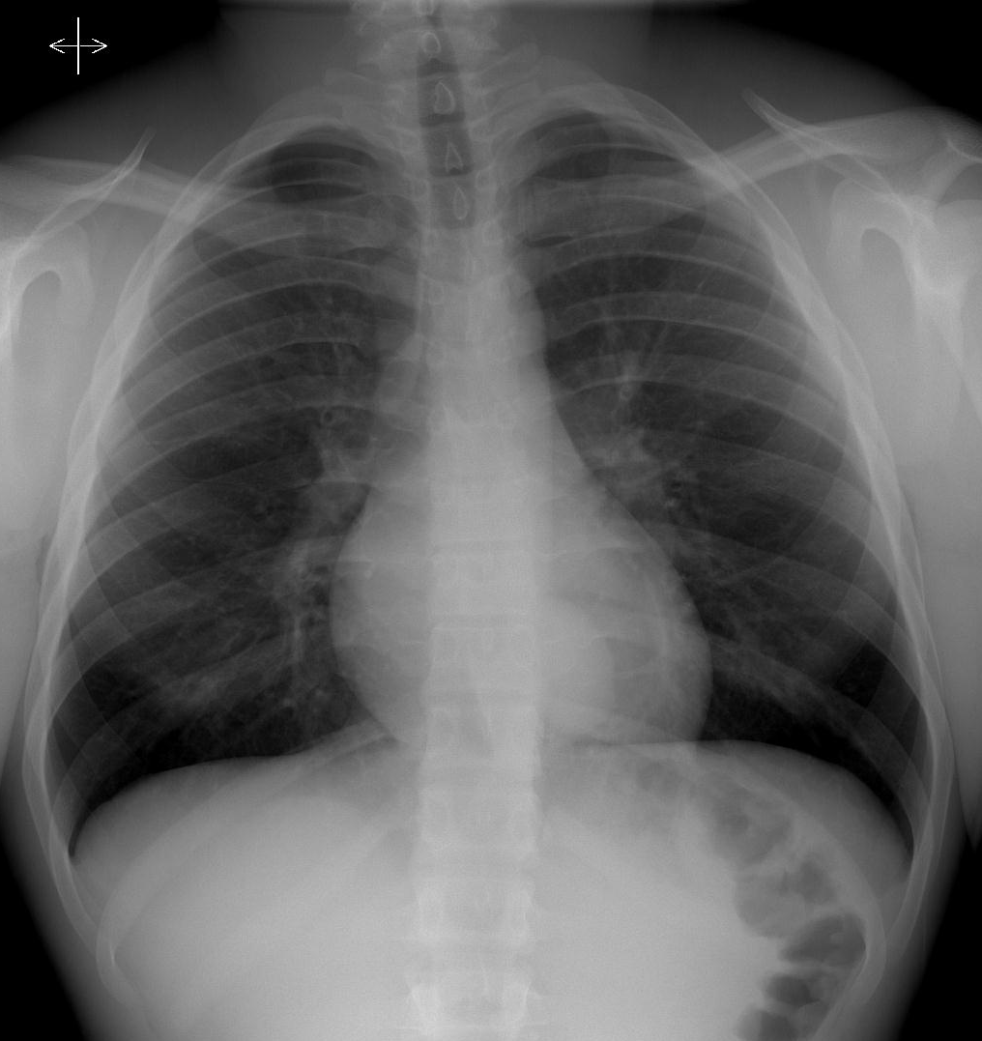
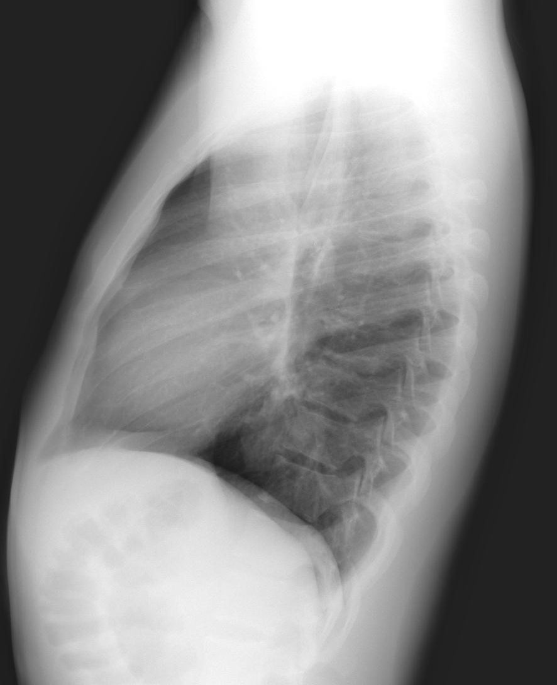
Retrocardiac Mass- Ganglioneuroma

Slide 31
D

Slide 32
Diaphragm

Slide 33
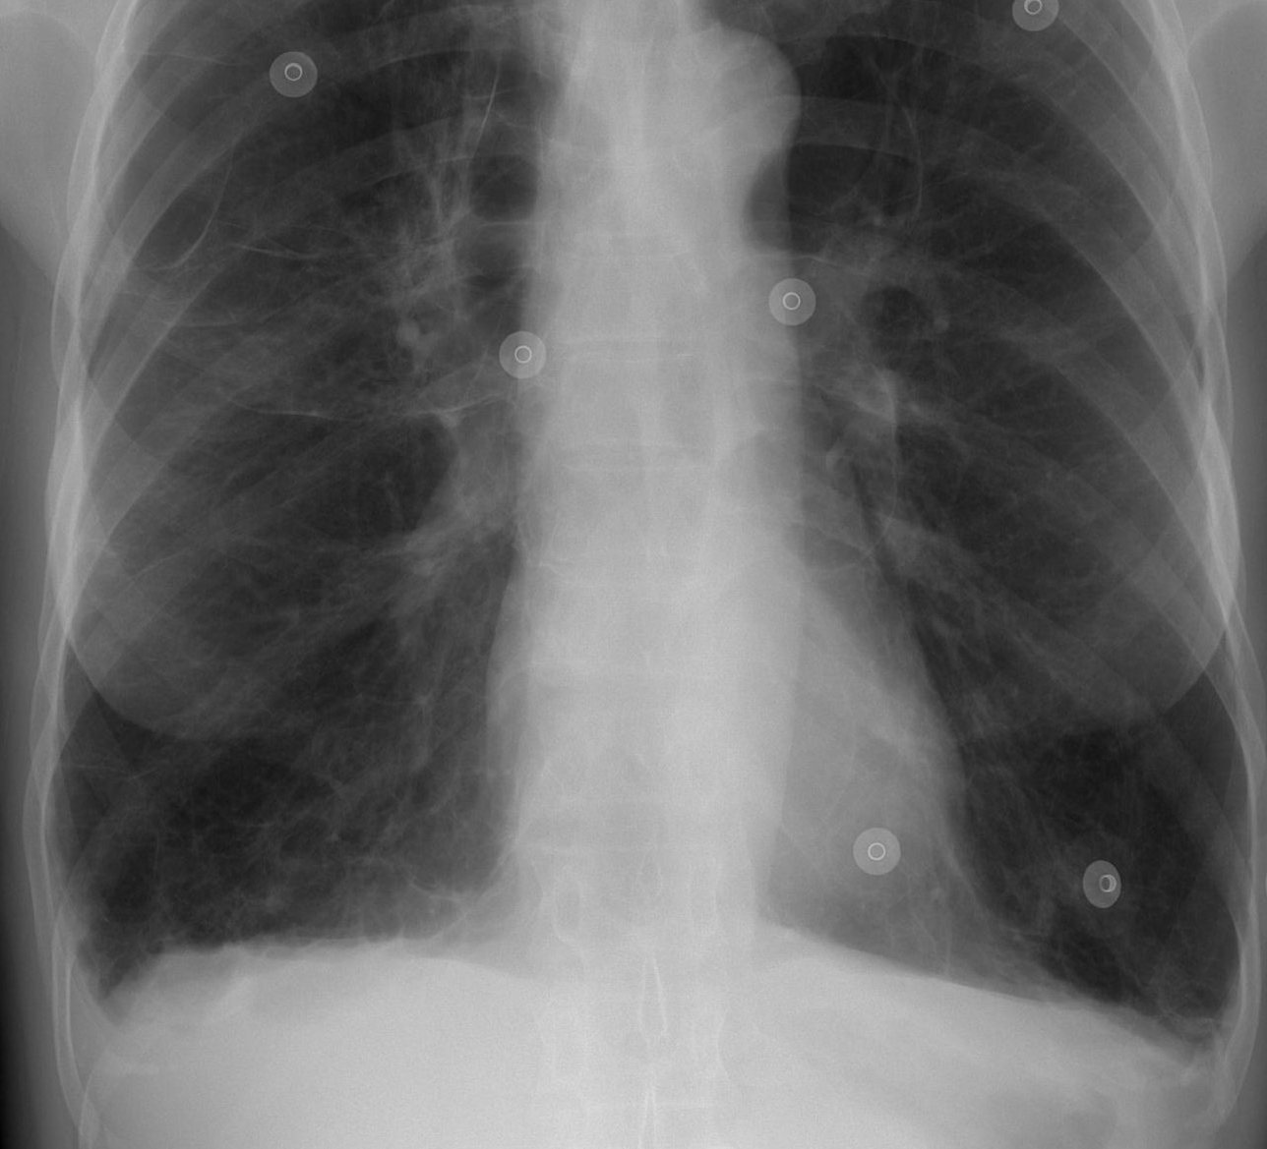
Chronic Obstructive Pulmonary Disease (COPD)

Slide 34
E

Slide 35
Effusions

Slide 36
Bilateral Pleural Effusions

Slide 37
F

Slide 39
Fields (Lung)

Slide 40
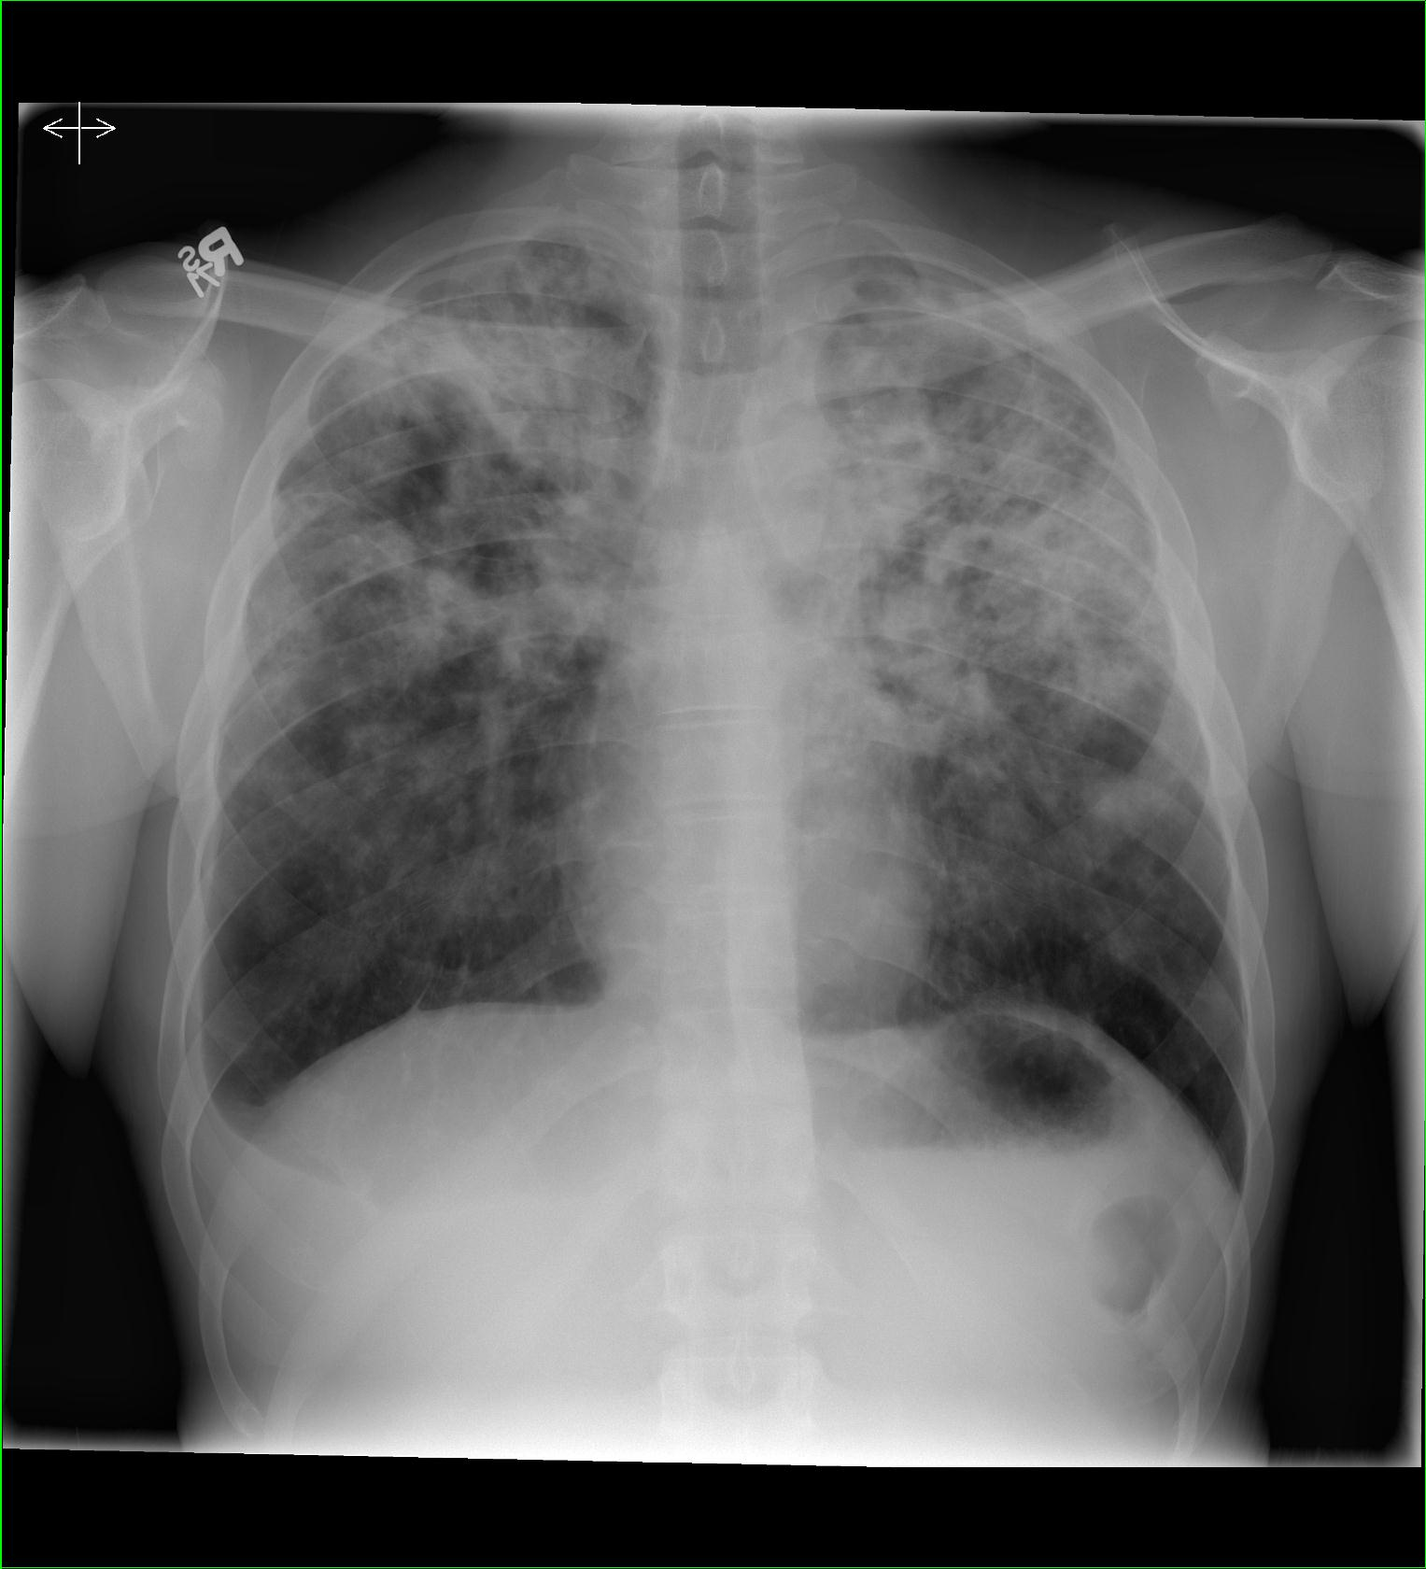
Bilateral Upper Lobes-Tuberculosis

Slide 41
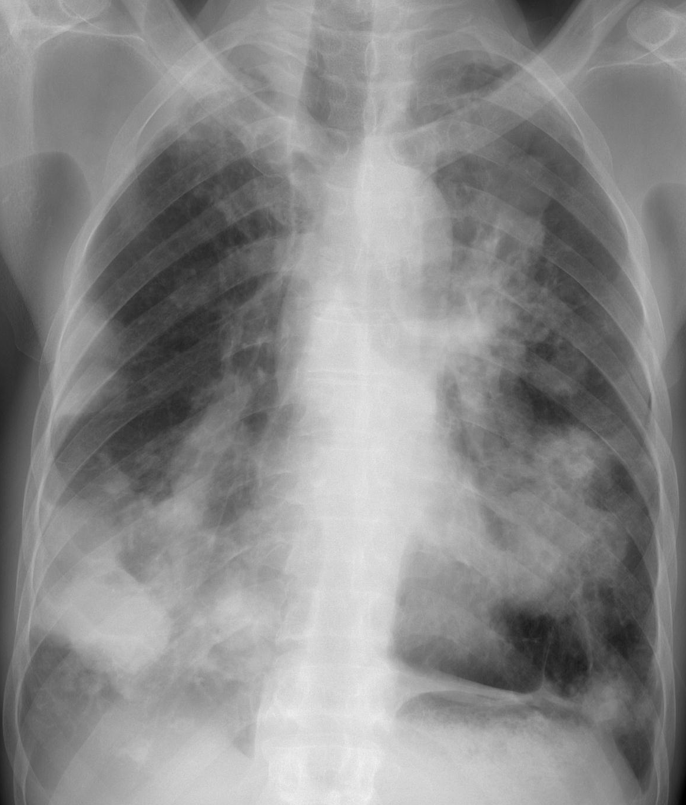
Metastatic Disease- Rectal Ca

Slide 42
G

Slide 43
Gastric Bubble

Slide 44
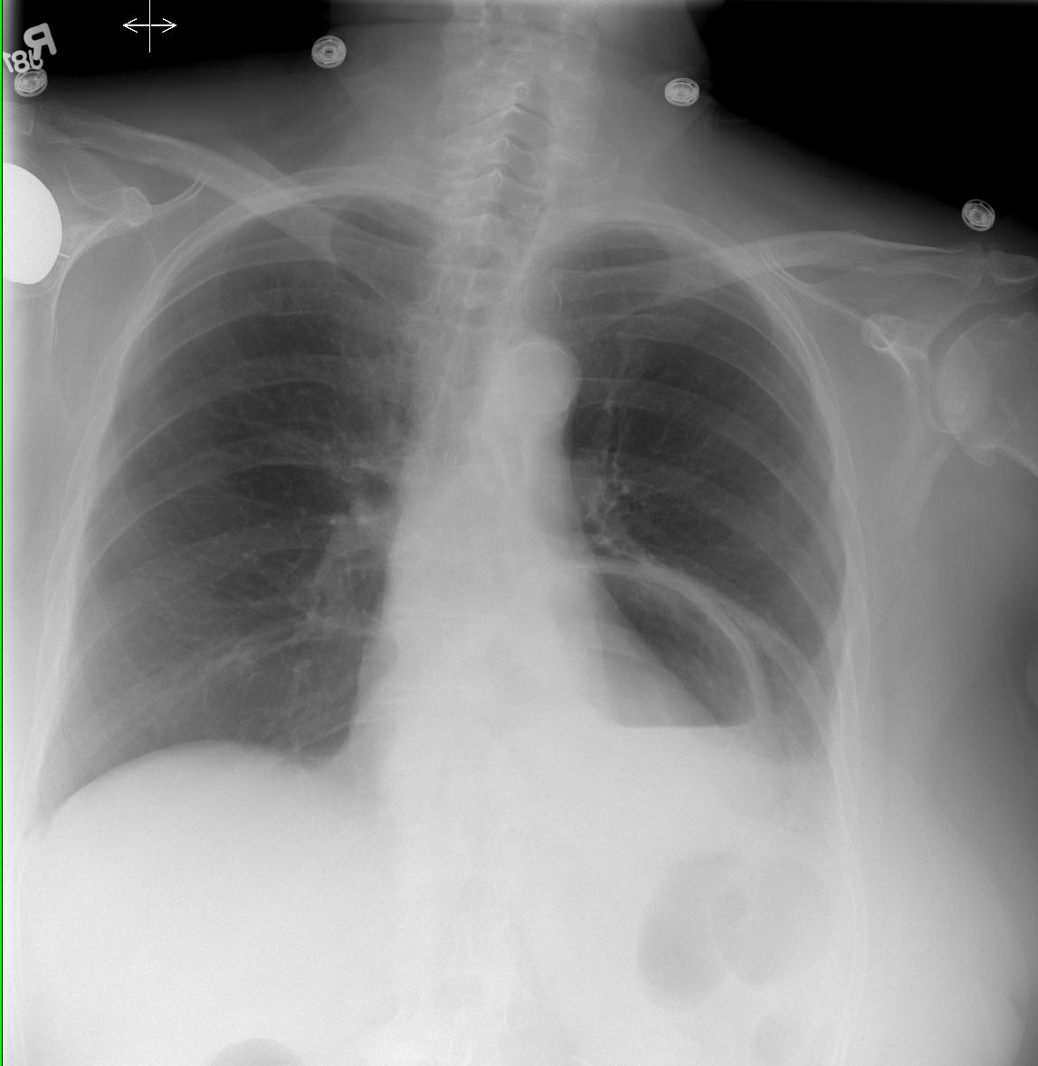
Hiatal Hernia

Slide 45
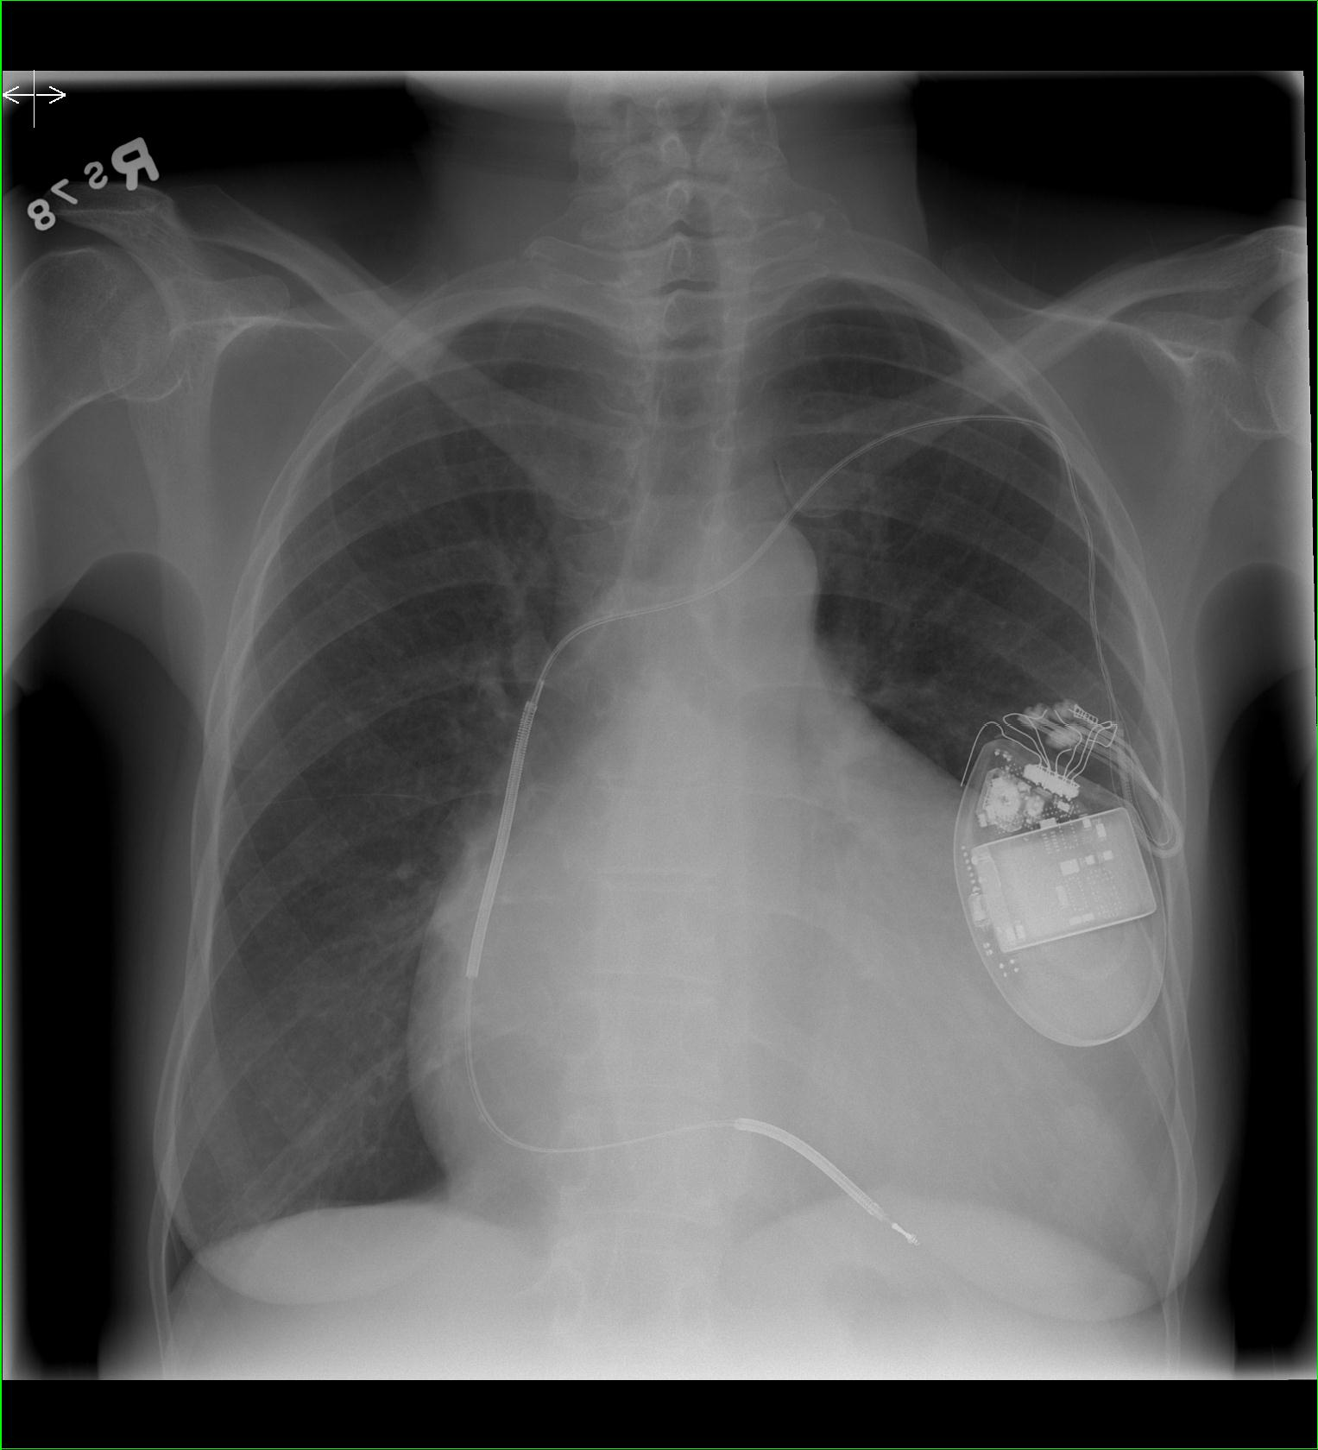
H

Slide 46
H
Hardware

Slide 47
Internal Cardiac Defibrillator (ICD)

Slide 48
Missing Engagement Ring!

Slide 49
Spinal Fusion Surgery
AND Right Pleural Effusion
?

Slide 50
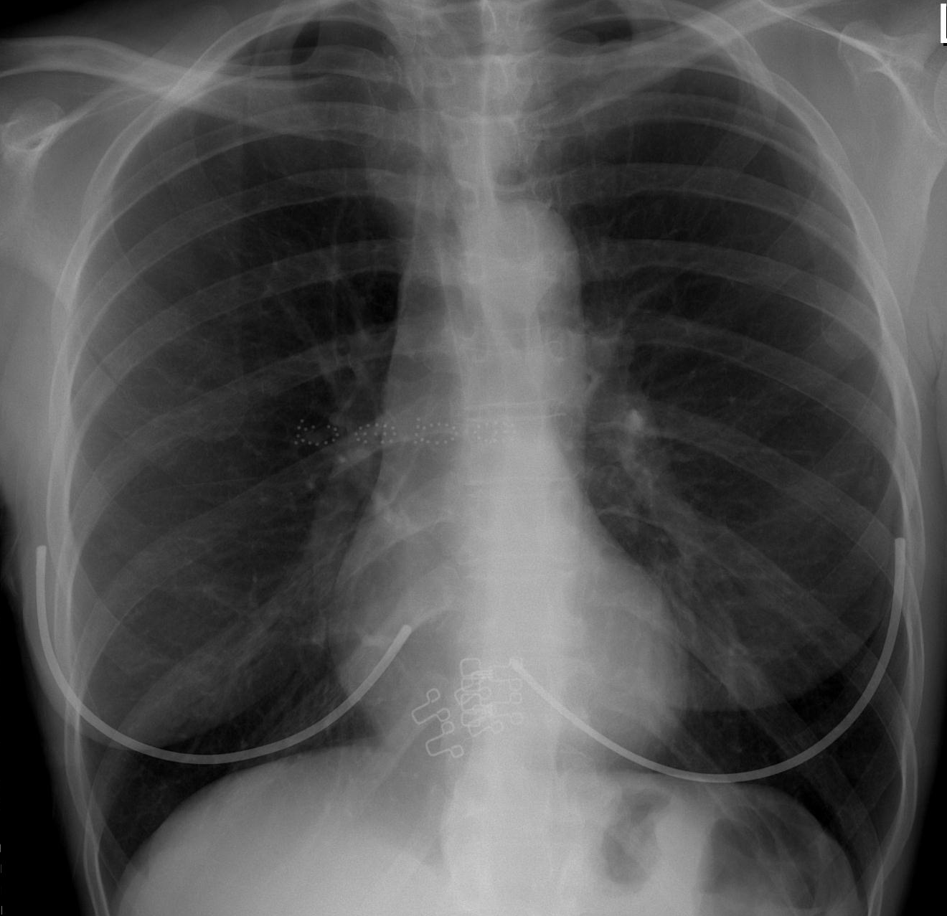
Clothing Artifact

Slide 51
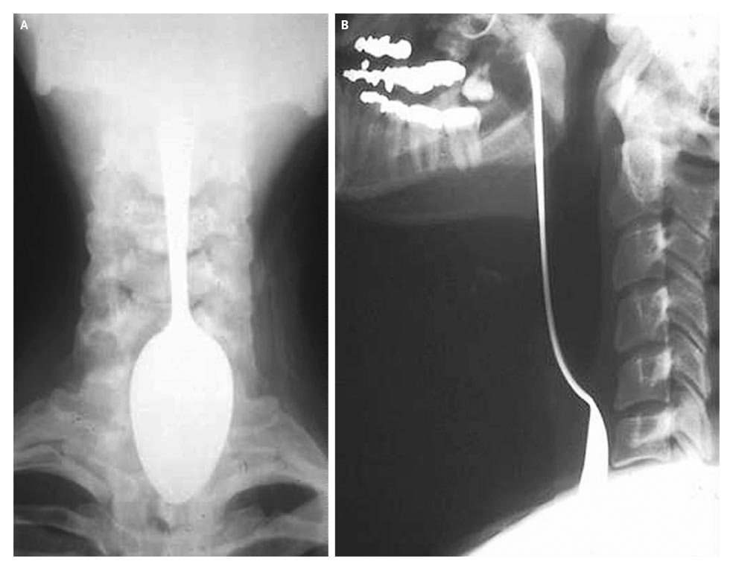
NEJM Image of the Week

Slide 52
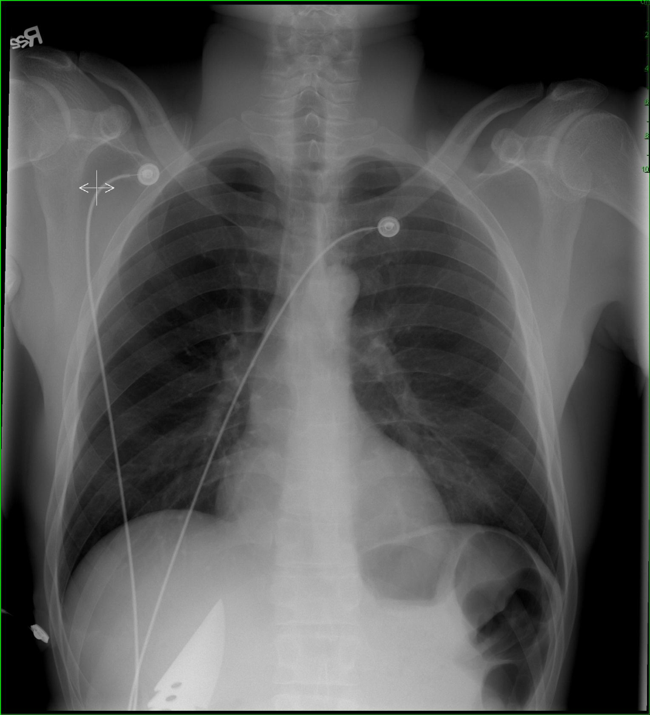
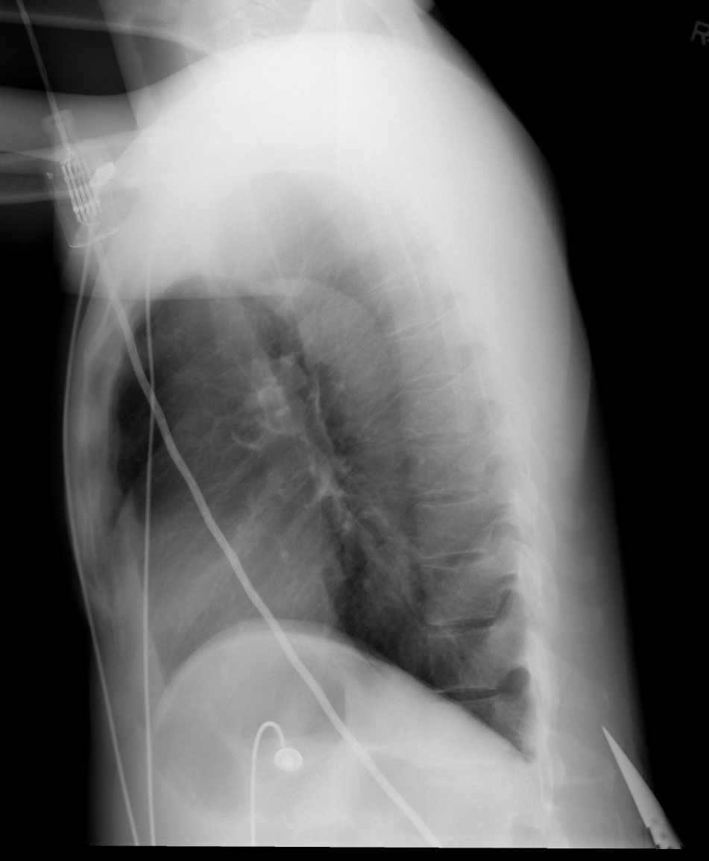
??????

Slide 53
Stab- Knife in Thorax

Slide 54
What are those Shades of Grey?
Airway
Effusions
Bones
Fields (Lung)
Cardiac
Gastric Bubble
Diaphragm
Hardware

Slide 55
What else can radiologists
do in the THORAX??

Slide 56
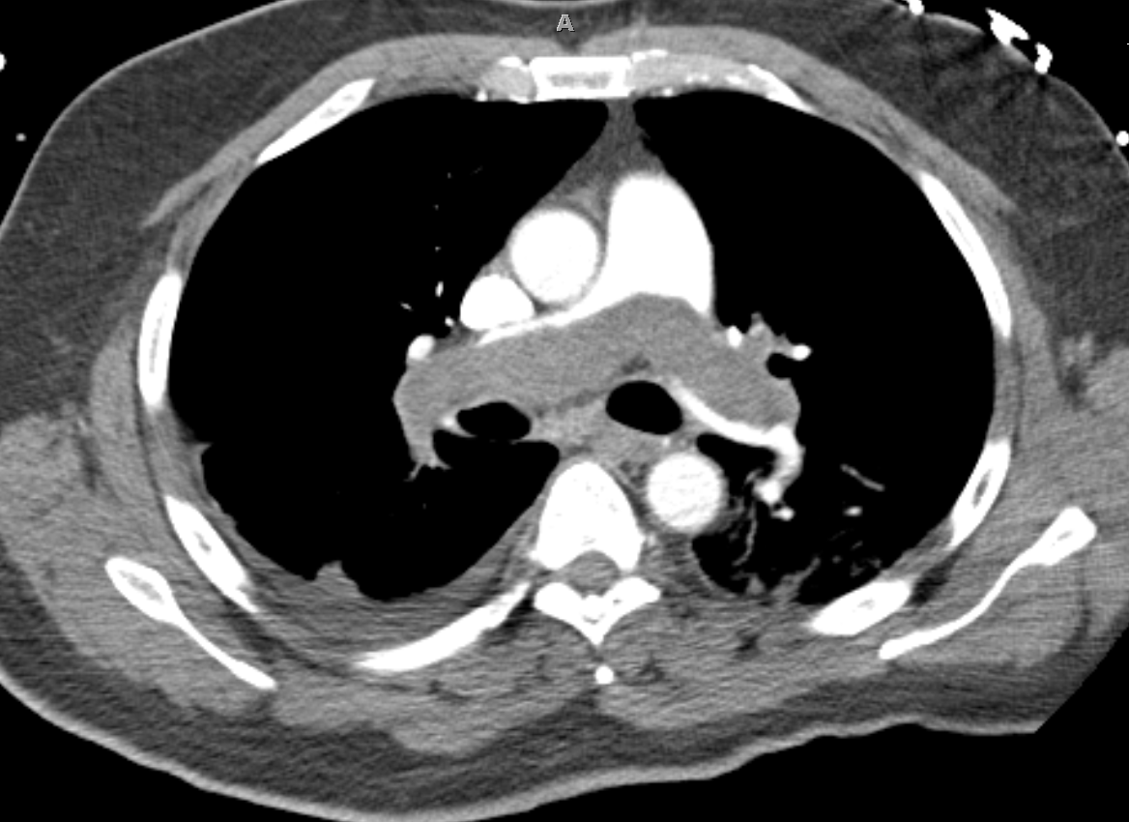
Chest CT – Pulmonary Embolism

Slide 57
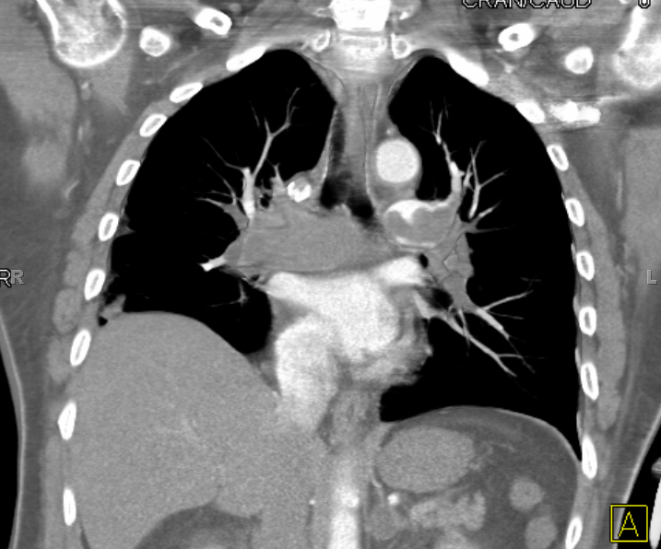
Chest CT – Pulmonary Embolism

Slide 58
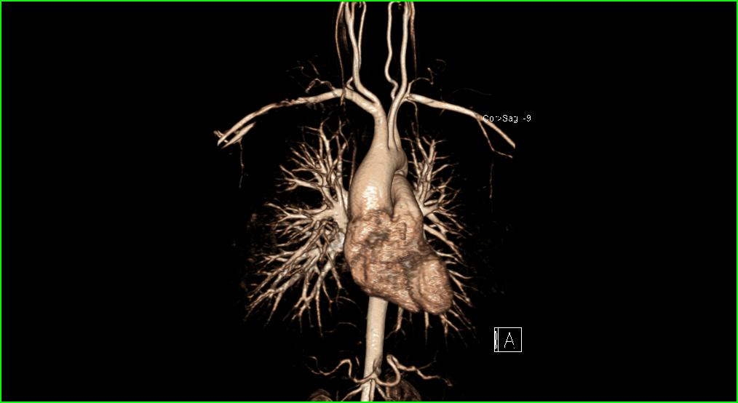
Magnetic Resonance Angiography (MRA)

Slide 59
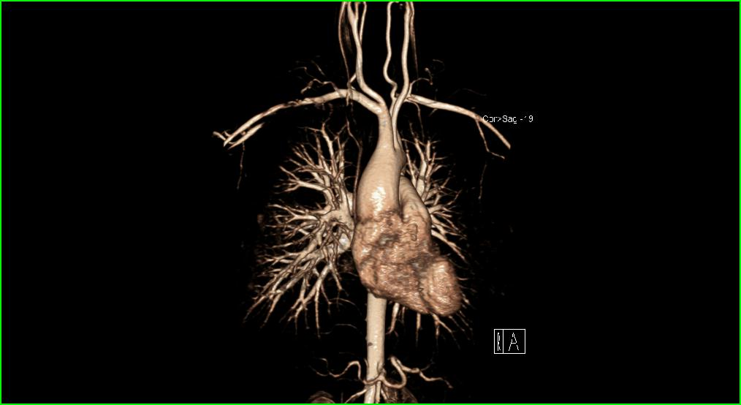
Magnetic Resonance Angiography (MRA)

Slide 60
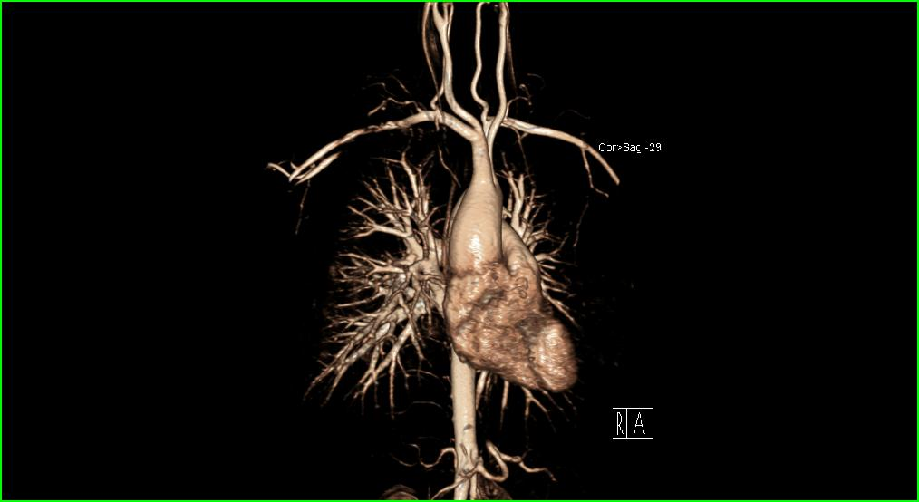
Magnetic Resonance Angiography (MRA)

Slide 61
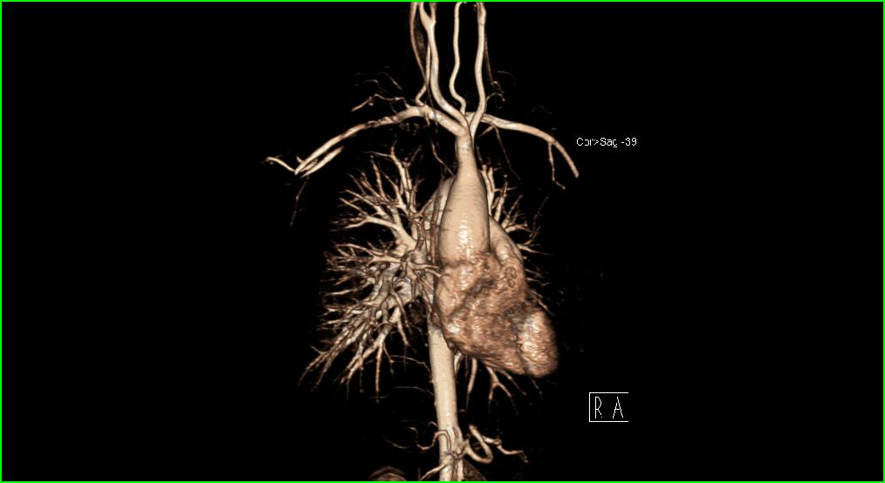
Magnetic Resonance Angiography (MRA)

Slide 62
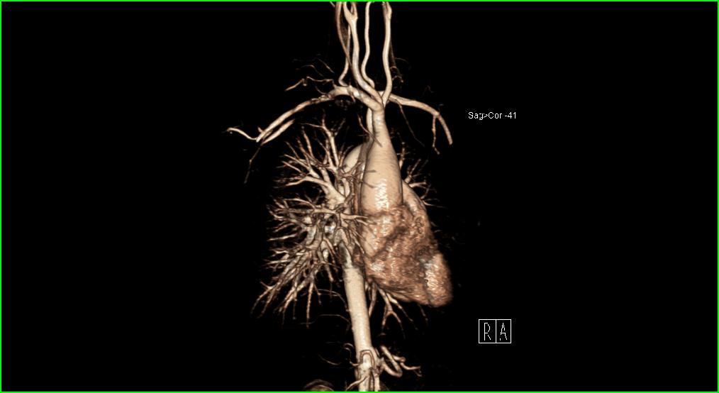
Magnetic Resonance Angiography (MRA)

Slide 63
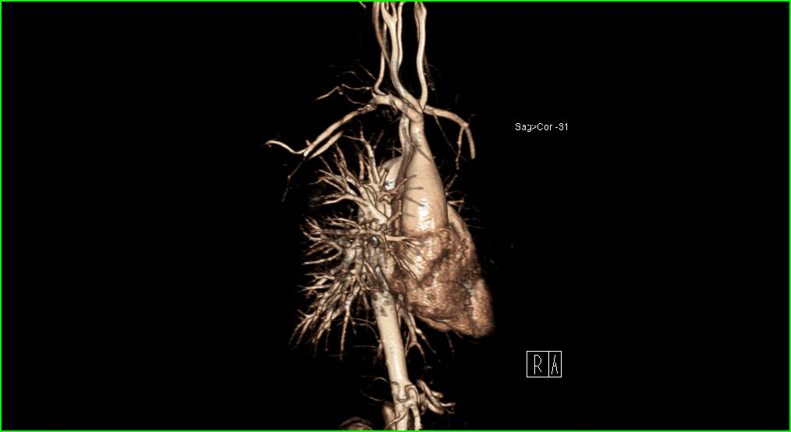
Magnetic Resonance Angiography (MRA)

Slide 64
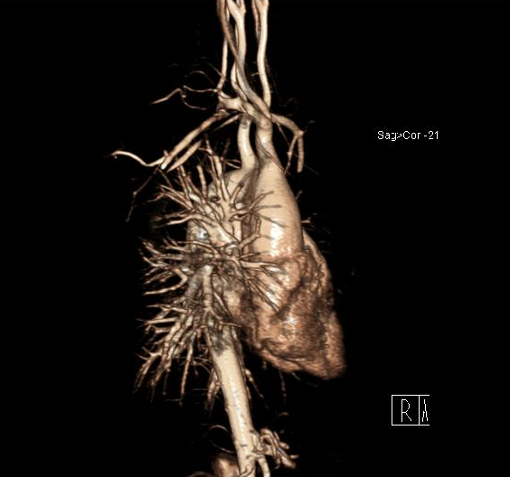
Magnetic Resonance Angiography (MRA)

Slide 65
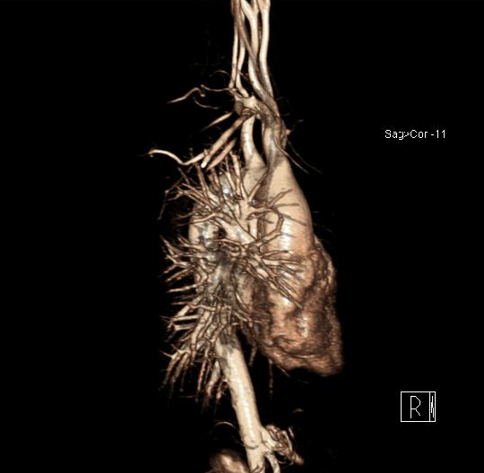
Magnetic Resonance Angiography (MRA)

Slide 66
Magnetic Resonance Angiography (MRA)

Slide 67
Take Home Points
ABC’s = starting point to organize approach to frontal chest images
Start to understand the “black and whites” of radiographic imaging
“One View Is No View”: Ideal Chest Study is PA/lateral images

Slide 68
Welcome to Hopkins!
dmagid@jhmi.edu
www.Teamrads.com

